Slide 1
Student Connect

Slide 2
What is Student Connect?
‘STUDENT CONNECT’ attempts to connect key stakeholders together through a hybrid app and an admin module (web app) which can be accessed through a browser.
Stakeholders:
Student
Parent
Faculty
Alumni

Slide 3
Technologies and Tools
Technologies.
Onsen Framework
JavaScript
jQuery
AJAX
Underscore.js
PHP
ASP.Net (C#)
HTML5
CSS
Tools.
Monaca Debugger
MSQL Workbench
Visual Studio
Filezilla

Slide 4
Environment setup
The mobile app would be accessed from the device.
The database is hosted on internet.
The business logic is implemented using PHP which is also hosted on internet.
ConnectyCube API(SDK platform) :hosted on the cloud.
2Factor API(for OTP).

Slide 5
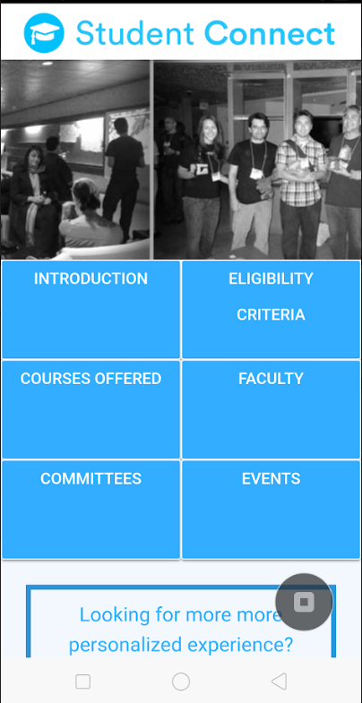
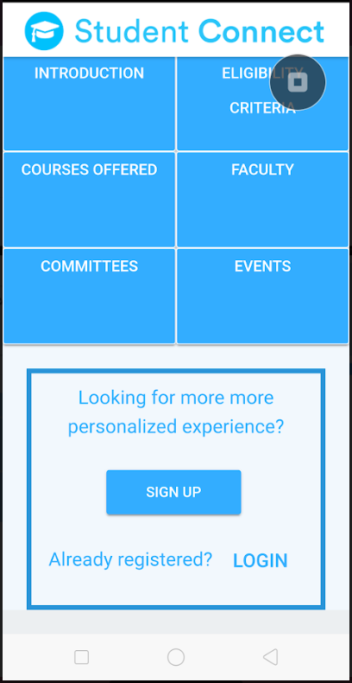
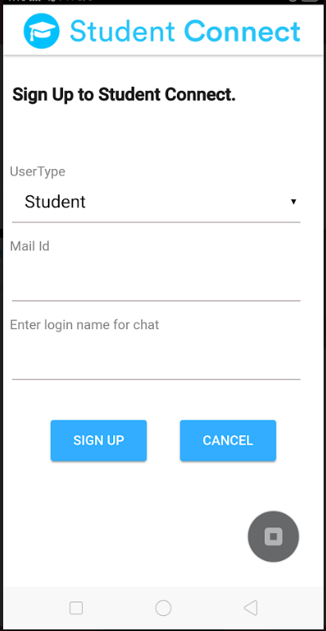

Slide 6
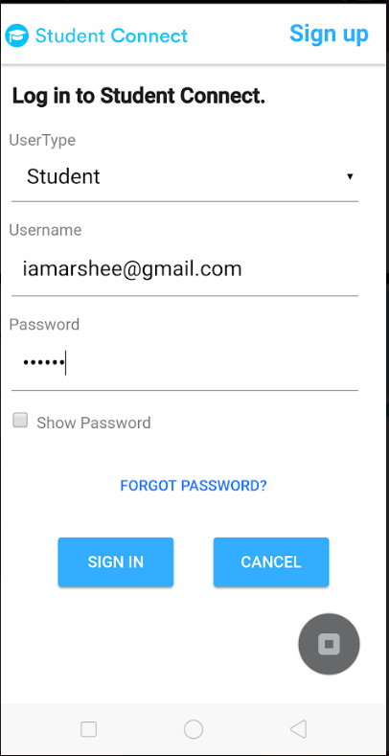
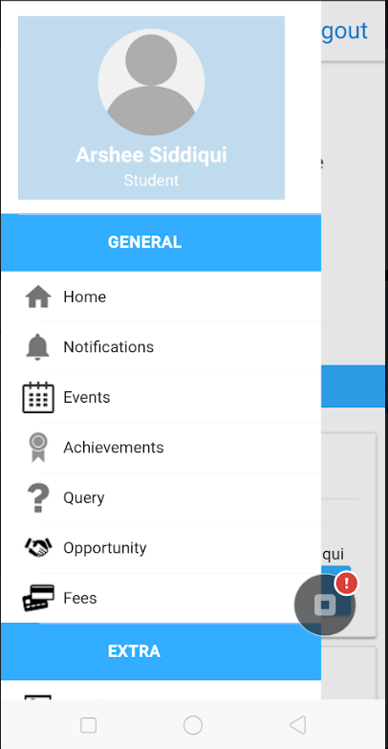
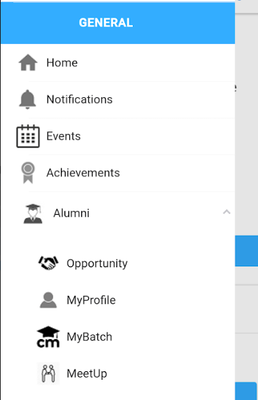
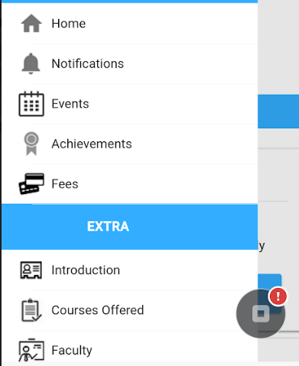
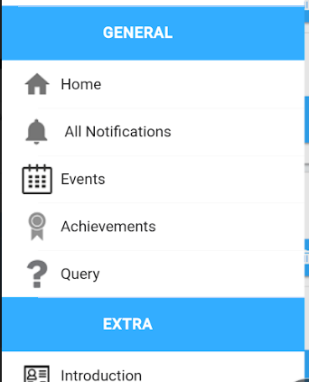

Slide 7
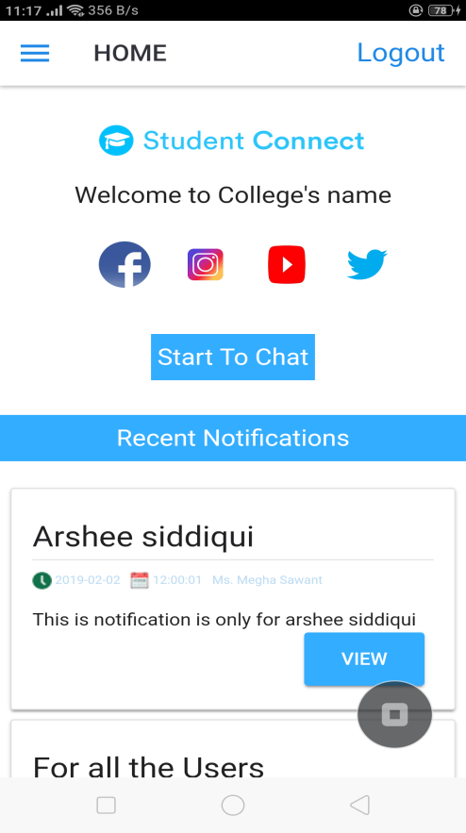
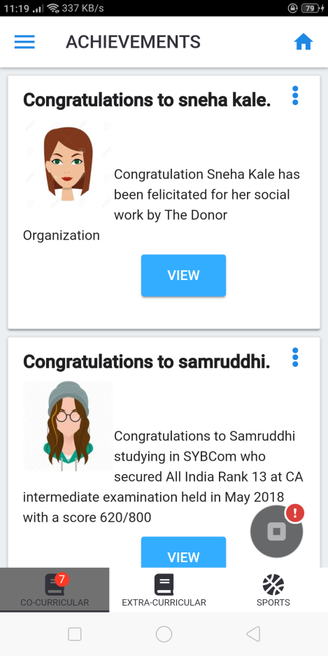
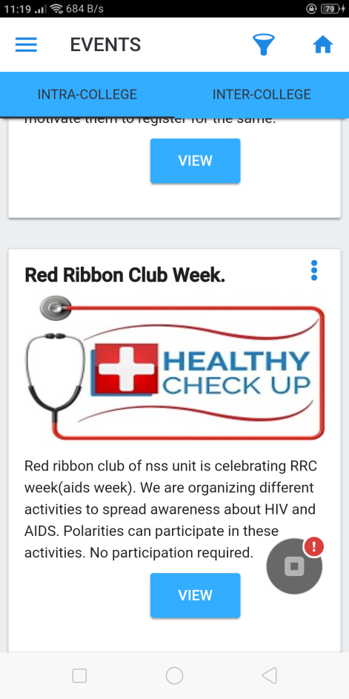
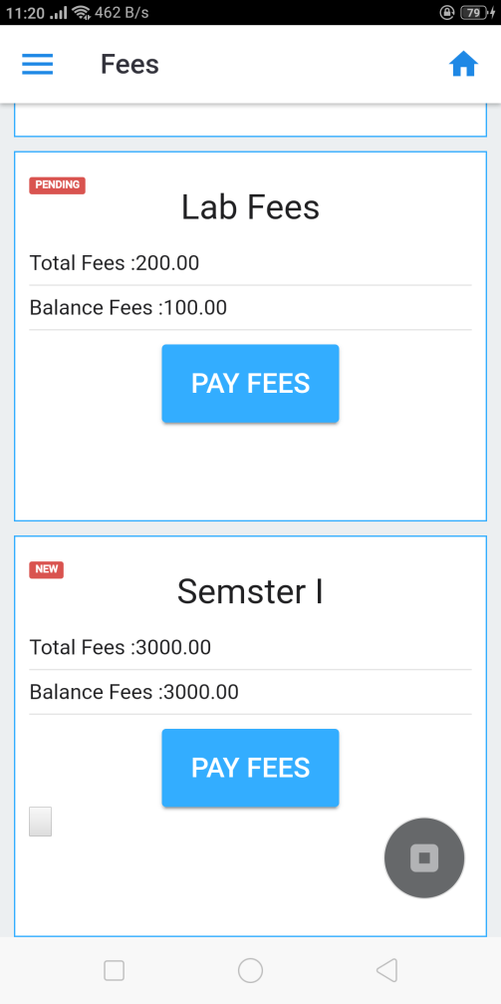
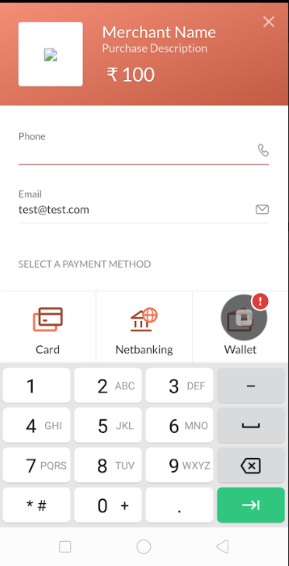

Slide 8
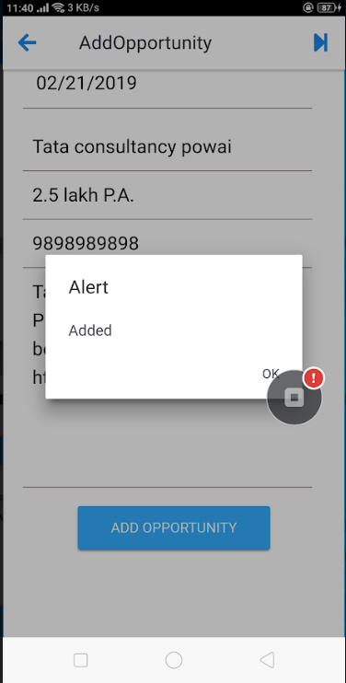
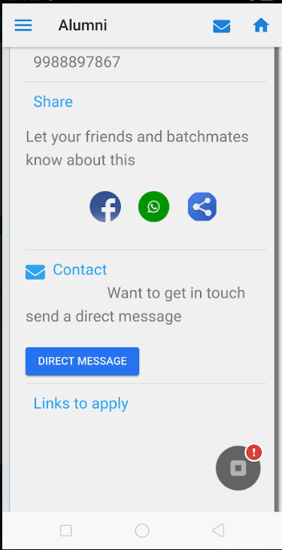
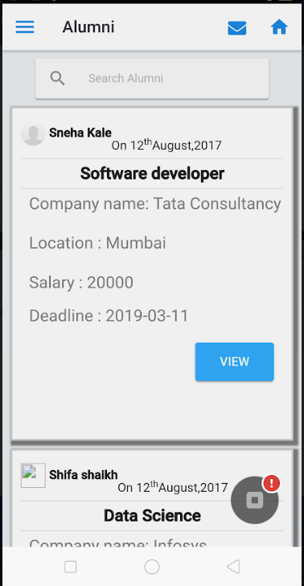
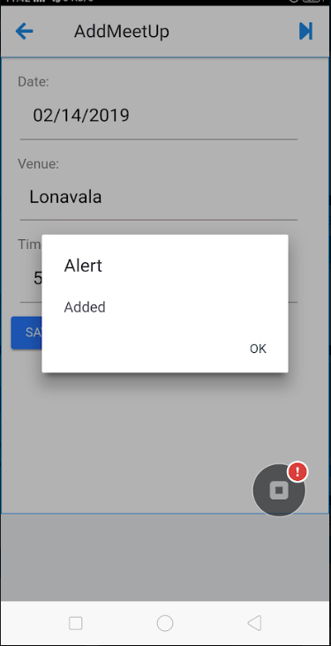
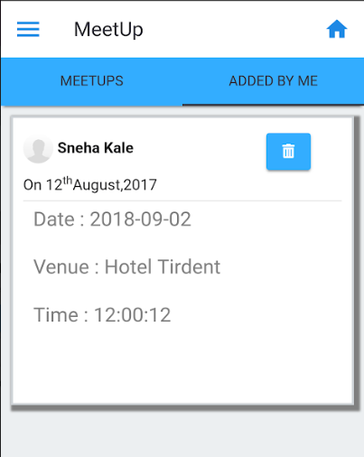
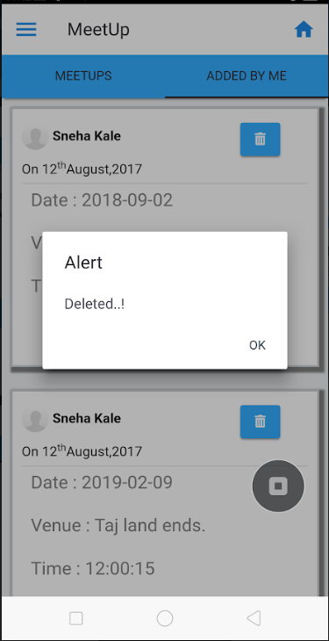

Slide 9
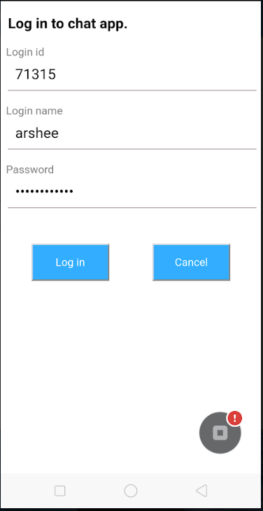
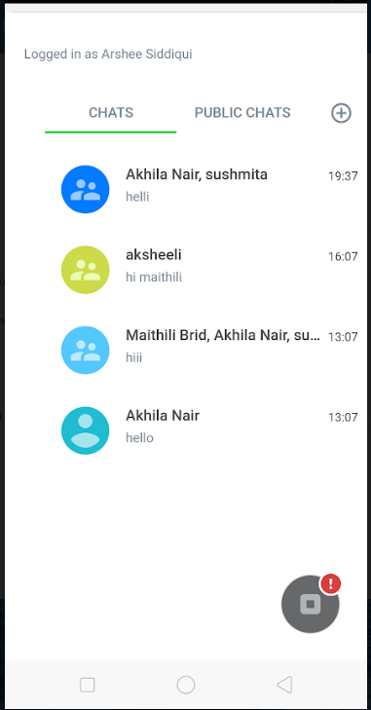
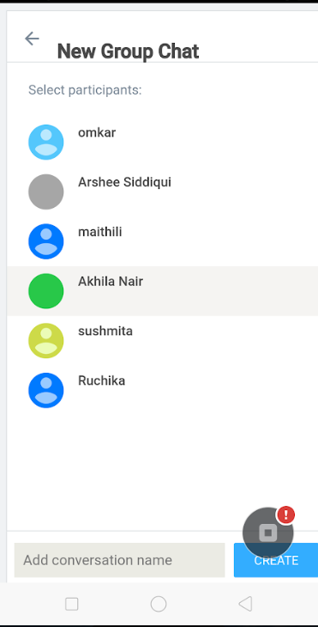

Slide 10
Thank You.

